Slide 1
BookWeek
Prize Winners

Slide 2
Treasure Hunt
Winning Team
Anuthra Thenahandi 7D
Anna Martin 7C
Ai Phanphengdy 7D

Slide 3
Daily Trivia
WINNERS
Monday: Danushi Marasinghe 10e
Tuesday: Sanduni Dharmaratne 11b
Wednesday: Santosh Shanmuganathan 10g
Thursday: Jesna Saju 7f
Friday: Will McKenzie 9D

Slide 4
Who/What is your Treasure?
Short-Story competition
1st prize: Lubna Musa 7H
2nd prize: Ciya Joseph 7C
3rd prize: Jasmin Pathiranage 7C
Most funniest prize: Daniel Andrews 7G
Most Inspiring prize: Pavani Dharmaratne 8C

Slide 5
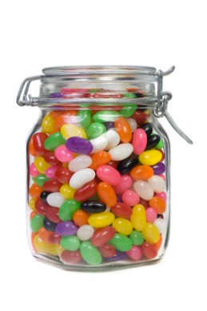
Guess the Lollies in the Jar
Winner
Jas Gill - 10c

Slide 6
Congratulations to
ALL
our winners

